Slide 1

Sales Analysis Report
This report provides a comprehensive overview of our sales and order data, offering insights into key trends and performance metrics.
Name: Khushi , UID: 23MCI10205

Slide 2

Objective:
A store, "Vrinda" wants to create an annual sales report for 2024. So that, they can understand their customers and grow sales in 2025

Slide 3
Sales Analysis Report: Key Objectives
Compare Sales and Orders
1
Analyze sales and order data using single charts for a comprehensive overview.
2
Identify Peak Month
Determine the month with the highest sales and orders to understand seasonal trends.
Gender-Based Purchasing
3
Compare the purchasing behaviour of men and women in 2024 to understand customer demographics.
4
Order Status Analysis
Explore the different order statuses in 2023 to understand fulfilment processes and potential bottlenecks.
Top Performing States
5
Identify the top 10 states contributing to sales to understand regional market performance.
6
Age and Gender Correlations
Analyze the relationship between age and gender based on the number of orders placed.
Channel Sales Performance
7
Identify the channel contributing the most to sales to optimize marketing strategies.
8
Best-Selling Categories
Determine the highest-selling category to understand customer preferences and product demand.

Slide 4

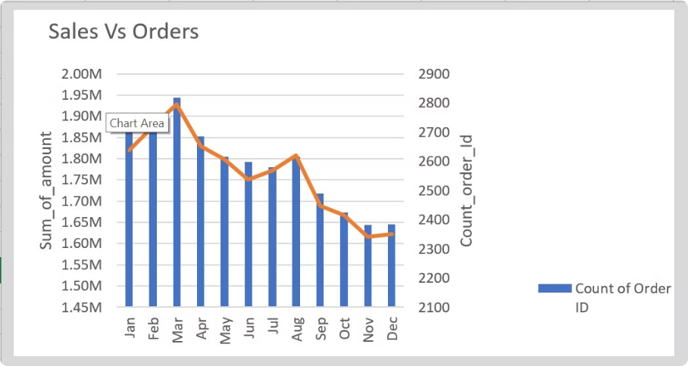
Analyze sales and order data using single charts for a comprehensive overview.
Determine the month with the highest sales and orders to understand seasonal trends.

Slide 5

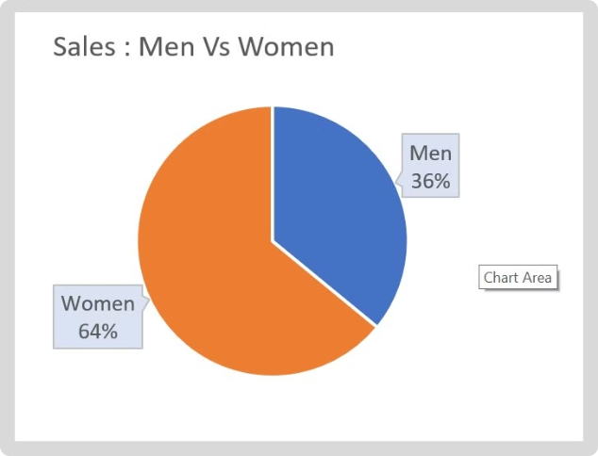
Gender-Based Purchasing
Who purchased more – men or women in 2024?

Slide 6

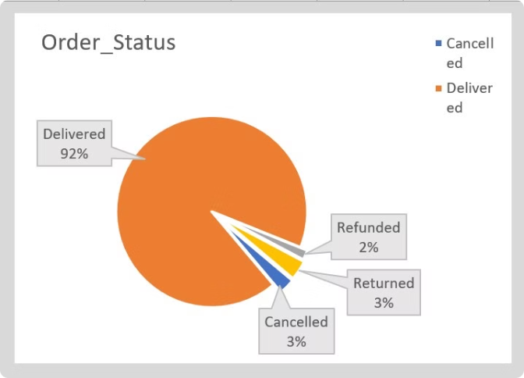
Order Status Analysis
Explore the different order statuses in 2023 to understand fulfilment processes and potential bottlenecks.

Slide 7

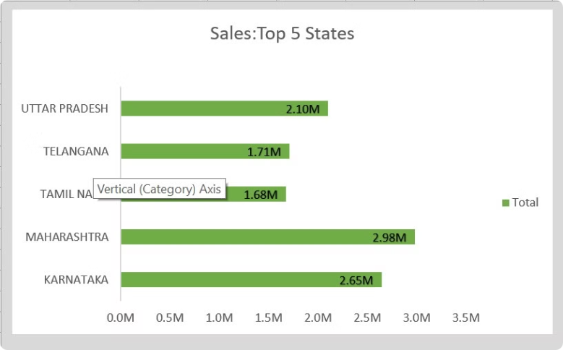
Top Performing States
Identify the top 5 states contributing to sales to understand regional market performance.

Slide 8

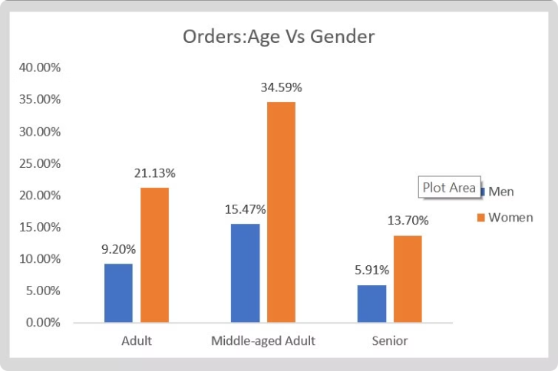
Age and Gender Correlations
Analyze the relationship between age and gender based on the number of orders placed.

Slide 9

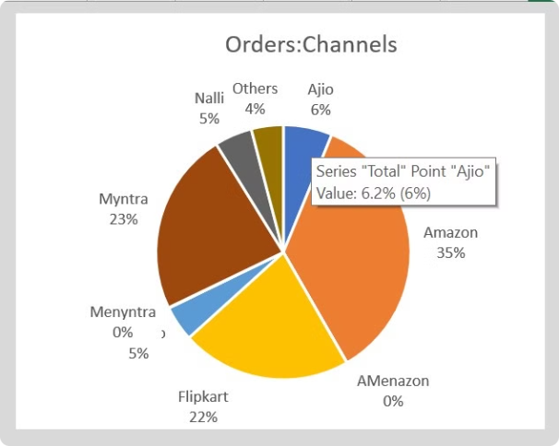
Channel Sales Performance
Identify the channel contributing the most to sales to optimize marketing strategies.

Slide 10
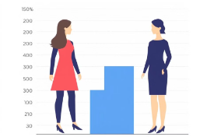
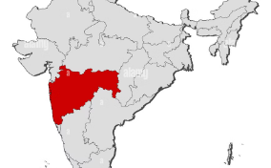
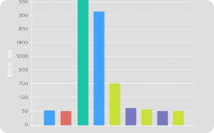

Insights
Gender Based Purchasing
Top Performing States
Age Group Breakdown
Channel Performance
Maharashtra, Karnataka and Uttar Pradesh are the top 3 states.
The adult age group (30-49 years) is the max contributor.
Amazon, Flipkart and Myntra are max contributors.
Women are more likely to buy compared to men (~65%).

Slide 11

Conclusion:
To improve Vrinda store sales
Target women customers of age group (30-49 yrs.) living in Maharashtra, Karnataka and Uttar Pradesh by showing ads/offers/coupons available on Amazon, Flipkart and Myntra .

Slide 12

Thank You
Khushi, UID: 23MCI10205

